Slide 1
Fundamental of Computer Hardware
Nahidul Islam
Lecturer, Dept. of CSE
Dhaka City College

Slide 2
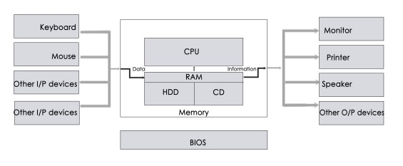
Introduction
Computer hardware refers to the physical components of a computer system that work together to process data, execute instructions, and perform tasks.

Slide 3
Classification of Hardware
Computer Hardware can be classified into five categories
Input Hardware – Keyboard, Mouse
Processing Hardware – CPU, RAM
Storage Hardware – Hard Disk, CD
Output Hardware – Monitor, Printer
Communication Hardware –Cable, Modem

Slide 4
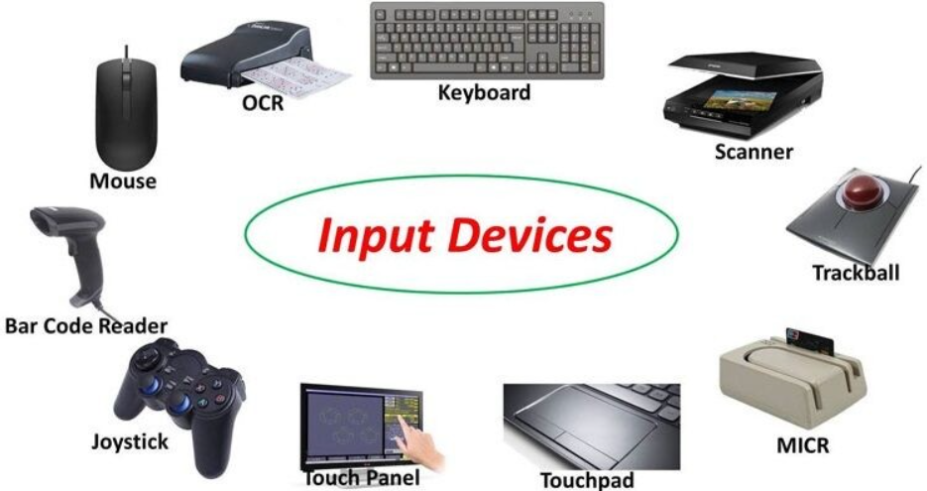
Input Hardware
An input device is a peripheral device which is used to collect data and convert it into a suitable form for next processing.

Slide 5
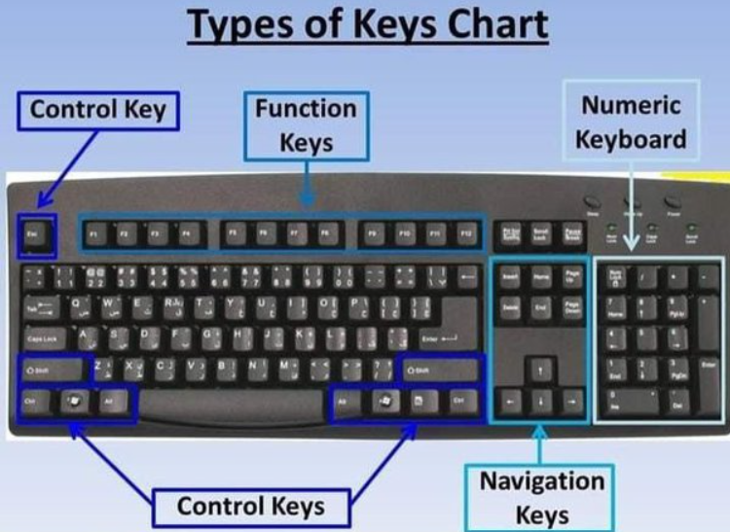
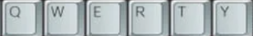
Keyboard
The most common and popular input device is used to enter text information into computers also can be used to type commands directing to the computer to perform certain actions.
A standard computer keyboard has 101 keys and each key ends a different signal to the CPU.
Layout:

Slide 6
Keyboard keys
Alphanumeric Keys: A-Z, Symbols(#, @, &)
Control Keys: Shift, Ctrl, Alt
Numeric Keys: 0-9,+,-,*,/
Function Keys: F1-F12
Movement Keys: Arrows(Left, Right, Up, Down), Back space, Space

Slide 7
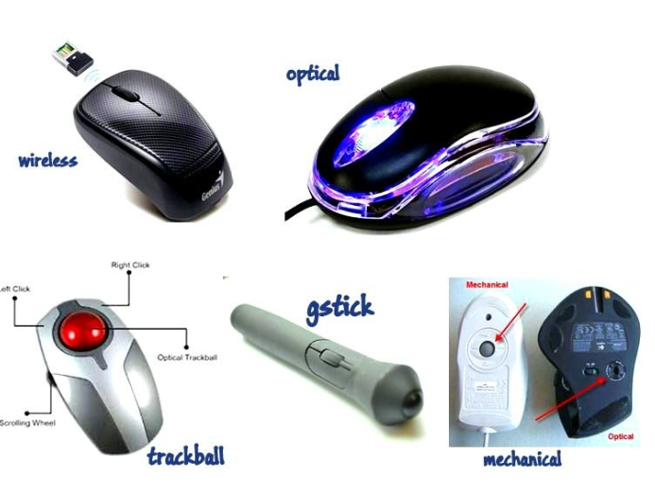
Mouse
Mouse is a pointing device, which is moved by hand over a flat surface to control the position of the cursor on computer display screen.
Mouse can be used to issue commands, draw, and perform other types of input tasks.
Using the mouse involves five techniques:
Pointing pointer
Clicking
Double-clicking
Dragging
Right Click

Slide 8
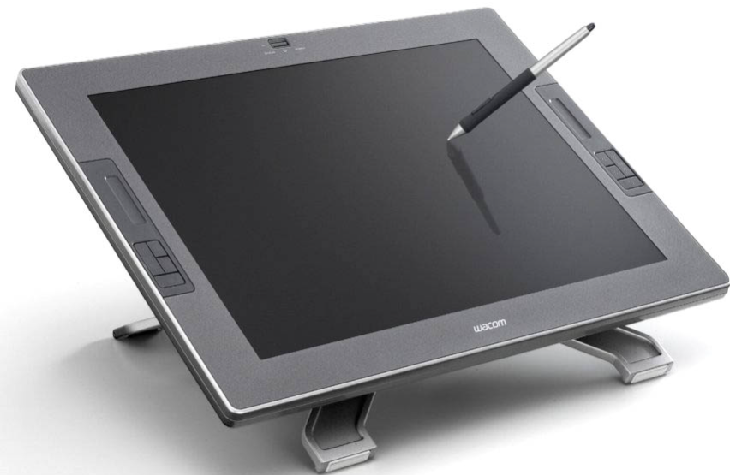
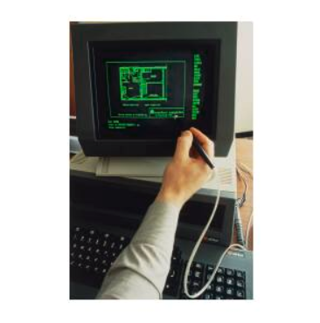
Light Pen, Digitizing Tablet
The light pen is a light sensitive stylus, or pen-like device, connected by a cable to the computer terminal.
A digitizer tablet, or simply a graphics tablet or pen tablet, is a peripheral input device for creating digital artwork.

Slide 9

Touch Screen
1. Resistive Touch Screens
Composed of two flexible layers separated by a small gap. When you press the top layer, it makes contact with the bottom layer, registering the touch.
2. Capacitive Touch Screens
Uses a transparent conductive layer. When a finger touches the screen, it alters the electrical field, allowing the system to detect the touch.
3. Infrared Touch Screens
Uses an array of infrared LEDs and sensors around the screen. When a finger interrupts the light beams, the system detects the location of the touch.

Slide 10
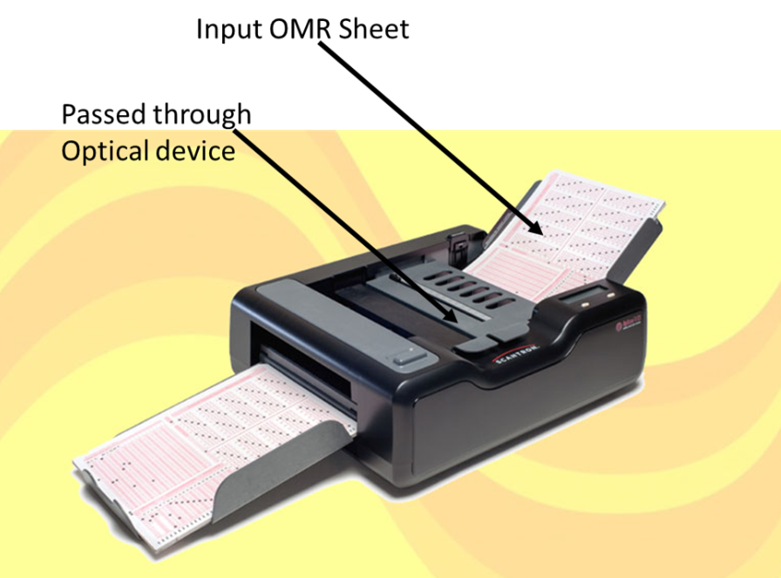
OMR(Optical Mark Reader)
OMR scanner is a hardware device/machine it has an optical device which is used to scan OMR sheets. The OMR scanner throws a light onto the filled form, the scanner then detects the contrasting areas of the light at certain positions on the form, some portion of the OMR detects black marks because less light is reflected from the area due to the filled area and unfilled area fully reflect the light, the contacting colors help to detects the answer filled by the participants.

Slide 11
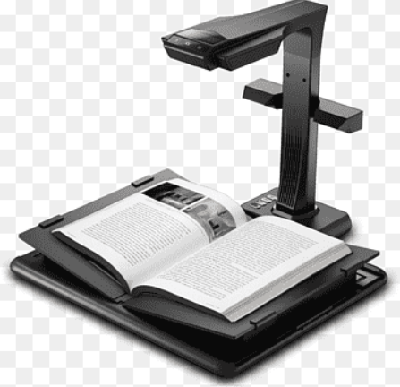
OCR(Optical Character Recognition)
OCR is a technology that converts various types of documents—scanned paper, images, PDFs—into editable and searchable digital text.
How It Works:
Image Acquisition: Capture an image of the document using a scanner or camera.
Preprocessing: Enhance the image through grayscale conversion, noise reduction, binarization.
Text Detection: Identify areas containing text, segmenting into blocks, lines, and characters.
Character Recognition: Use pattern recognition, feature extraction, and machine learning to identify characters.
Post-Processing: Improve accuracy with dictionaries and language models.
Output: Export the recognized text into formats like plain text or PDFs.

Slide 12
MICR(Magnetic Ink Character Recognition)
MICR is a technology used in recognition of originality of document with the help of special ink and character.
Bank’s code number and cheque number are printed on the cheque that contain particle of magnetic iron material that are machine readable. These readers, equipped with magnetic sensors, detect the magnetic signals generated by the ink. The MICR detects the ink’s magnetic patterns and compares it to the types of patterns in its memory.
MICR Code: Three digit signifies about city code, next three about represent bank code, and last three about branch code.
It is majorly used by bank to process and clear cheque.

Slide 13
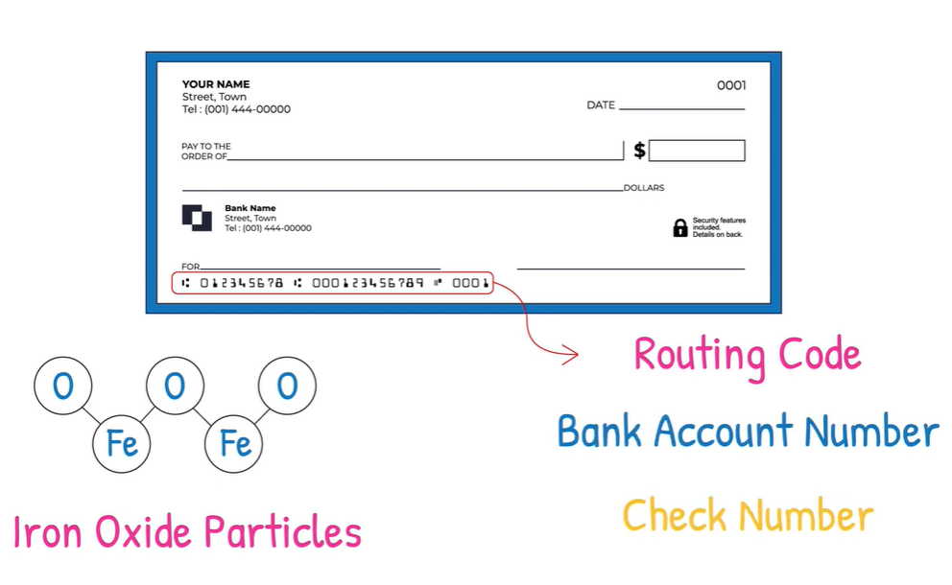
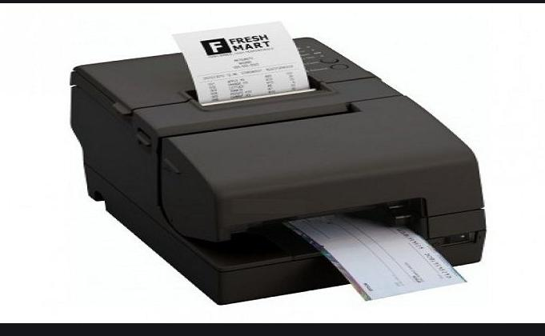
MICR(Magnetic Ink Character Recognition)
MICR

Slide 14
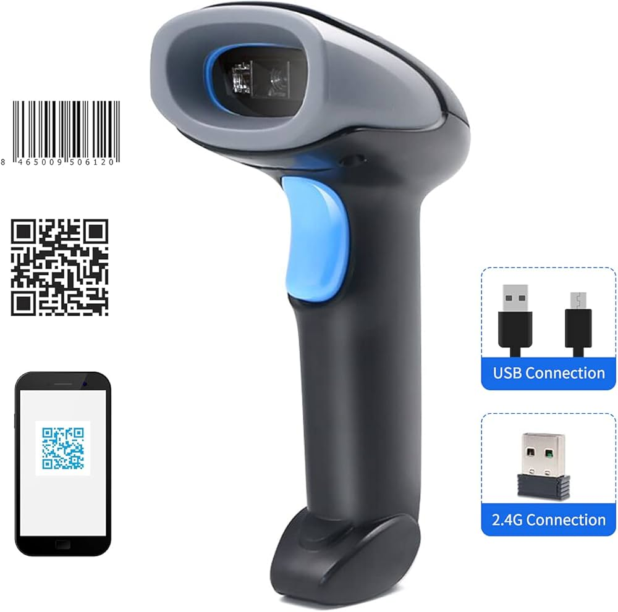
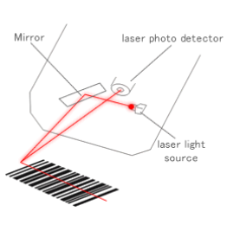
Bar Code Reader
A barcode scanner usually consists of three different parts including the illumination system, the sensor, and the decoder. In general, a barcode scanner “scans” the black and white elements of a barcode by illuminating the code with a red laser light, which is then converted into matching text. More specifically, the sensor in the barcode scanner detects the reflected light from the illumination system (the red light) and generates an analog signal that is sent to the decoder. The decoder interprets that signal, validates the barcode using the check digit, and converts it into text. This converted text is delivered by the scanner to a computer software system holding a database of the maker, cost, and quantity of all products sold.

Slide 15
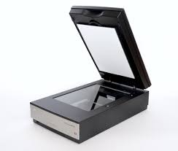
Scanner
A scanner is an input device, through which we can convert hard copy into soft copy. With the help of scanner text on paper, images, graphics and characters are scanned and stored in the computer. The most popular type of optical scanner is a flatbed scanner, which scans documents on a flat surface.
How It Works:
Document Placement: The item to be scanned is placed face down on the glass surface.
Light Source: A light source illuminates the document as the scanner head moves across it.
Image Capture: Sensors capture the reflected light and convert it into a digital image.
Output: The scanned image is processed and saved in various formats (e.g., JPEG, PDF)

Slide 16
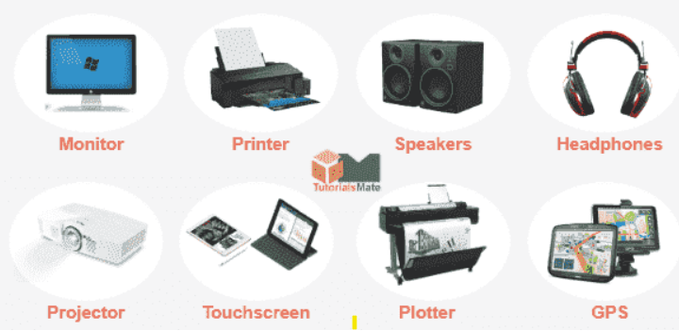
Output Hardware
Output hardware refers to the physical devices that allow a computer system to communicate the results of its processing to the user or to other systems. These devices take the data processed by the computer and convert it into a form that humans can easily understand.

Slide 17
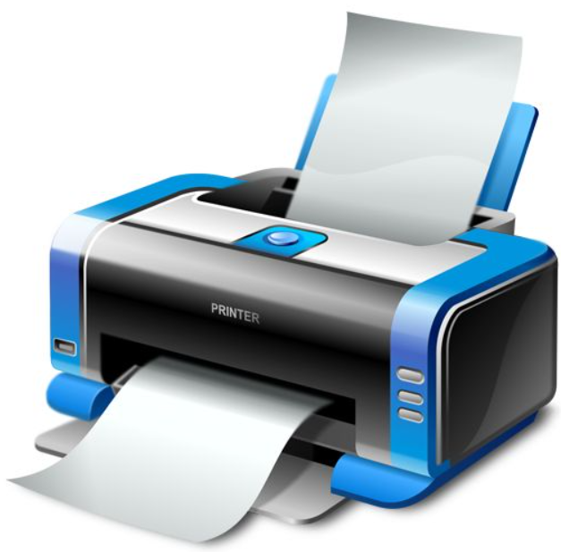
Printer
A printer is an output device that produces text and graphics on a physical medium such as paper.
Speed: usually expressed in PPM (Pages per Minute) , LPM(Lines per Minute), CPS(Characters per Second).
Resolution: expressed as dot per inch(dpi)

Slide 18
Classification of Printer
Printer
Impact
Non-impact
Character
Line
Dot Matrix
Daisy Wheel
Drum
Chain
Inkjet
Laser
Thermal

Slide 19
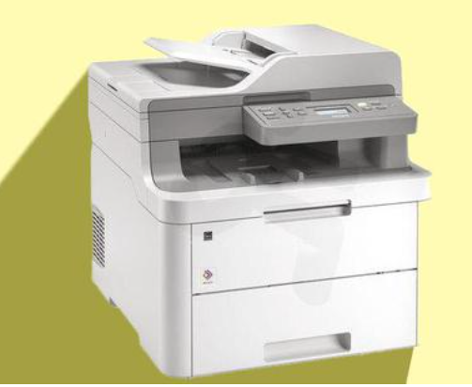
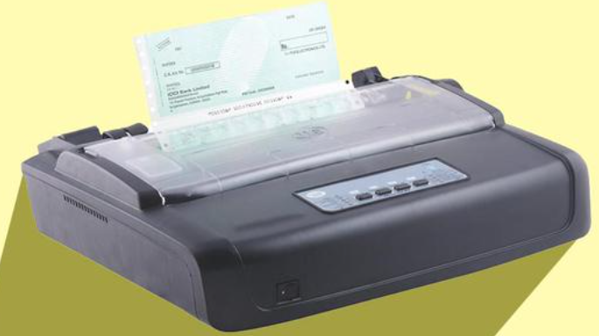
Impact vs Non-impact
Impact Printers: Impact printers work by physically striking an ink ribbon against the paper to form characters or images. This category of printers is named for the "impact" that occurs during the printing process.
Non-Impact Printers: Non-impact printers use various methods to apply ink or toner to paper without any mechanical impact. These printers are generally faster, quieter, and capable of producing high-quality prints.

Slide 20
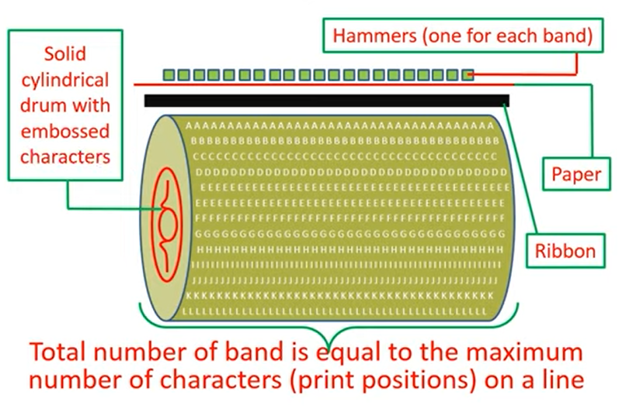
Drum Printer
Drum Structure: The printer uses a cylindrical drum that is coated with ink. The drum has pre-formed characters or symbols arranged around its surface.
Rotation: As the drum rotates, it brings the desired character into position in front of the paper.
Impact Printing: A print head, which contains hammers or pins, strikes the paper against the rotating drum. The impact transfers the ink from the drum to the paper, creating an impression of the character.
Continuous Motion: The drum continues to rotate, bringing the next character into position for printing, allowing for continuous printing of text and graphics.
Fig: Drum printer

Slide 21
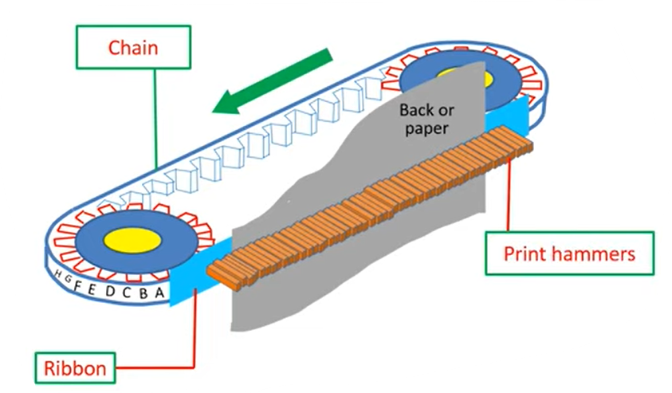
Chain Printer
Chain Structure: The printer uses a continuous chain that has a series of type characters (like a typewriter) attached to it. Each character is positioned at regular intervals along the chain.
Movement: The chain moves horizontally, and as it advances, the desired character is positioned in front of the paper.
Impact Printing: A print head with hammers strikes the paper against the character on the chain. This impact transfers ink from the character to the paper, creating the printed text.
Continuous Operation: The chain keeps moving, allowing for the next character to be printed immediately after the previous one, resulting in continuous printing.

Slide 22
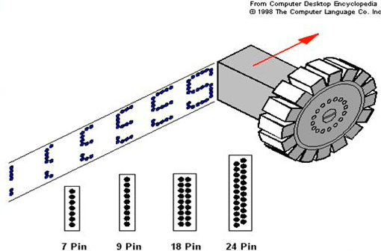
Dot Matrix
Print Head: The printer has a print head that contains a series of tiny pins (typically 7 to 24) arranged in a vertical line.
Movement: The print head moves horizontally across the paper. As it moves, the pins are activated to strike an ink-soaked ribbon against the paper.
Dot Formation: Each activated pin creates a small dot on the paper by pushing the ribbon against it. By controlling which pins are activated, the printer can form characters and graphics from a matrix of dots.
Vertical Motion: Once a line of text is printed, the paper advances vertically, and the print head returns to the starting position for the next line.

Slide 23
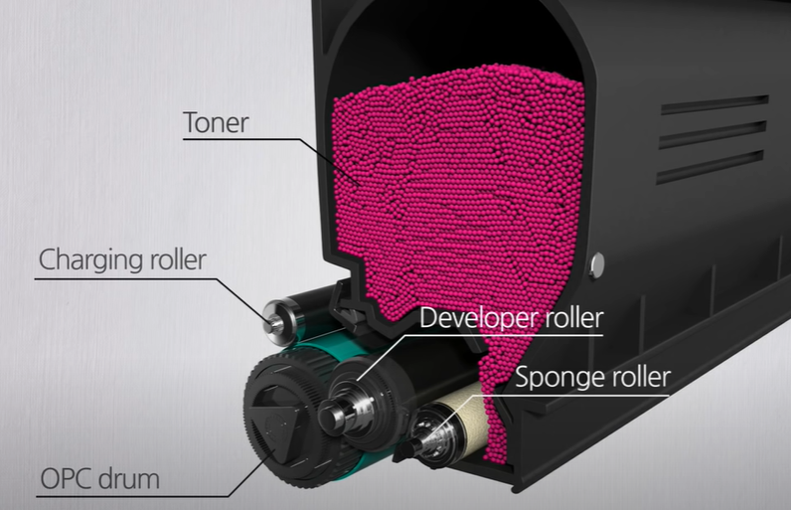
Laser Printer
Charging: The printer's drum(OPC organic Photoconductor), typically made of a photoconductive material, is charged with a high-voltage roller. This creates a uniform negative charge on the surface of the drum.
Writing: A laser beam is directed onto the drum, selectively discharging areas according to the image or text to be printed. The laser light alters the charge of the drum in those specific areas, creating a latent image.
Developing: The drum is then coated with toner, which is a fine powder made of plastic particles and pigments. The negatively charged toner particles adhere to the positively charged areas on the drum where the laser has discharged the charge.
Transfer: The drum rolls against a sheet of paper, which is given a negative charge. The toner is attracted to the paper, transferring the image from the drum to the paper.
Fusing: The paper then passes through a fuser unit, which uses heat and pressure to melt the toner particles onto the paper, ensuring that the image is permanently bonded.
Cleaning: Any residual toner left on the drum is removed by a cleaning blade, preparing the drum for the next print cycle.
Laser Printer

Slide 24
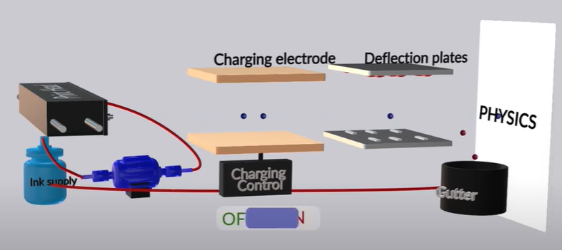
Inkjet Printer
Ink Supplier: The printer uses ink supplier that contain liquid ink in various colors (usually cyan, magenta, yellow, and black - CMYK).
Print Head: The print head is a critical component that moves back and forth across the paper. It contains several nozzles (or jets) that spray the ink.
Droplet Formation: The ink is forced through the nozzles in the print head.
Paper Feeding: As the print head moves, the paper is fed through the printer, allowing the print head to apply ink in a precise pattern to form characters and images.
5.Repetition: The print head moves back to the starting position and repeats the process to build up the full image or text, layer by layer.

Slide 25
Factor for Selecting Printers
Speed:
define how many pages can be print per minute.
Cost:
cost of the printer
cost of the ink
cost of the paper or others materials
Resolution:
text or image quality can be rated in resolution such as dpi(dot per inch)
Connectivity:
using parallel(36 pin) port
both parallel port and USB
connect to the network
Duplexing:
refers to the ability to print on both side of a paper.

Slide 26
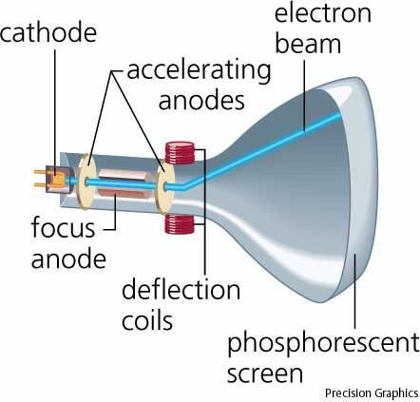
CRT(Cathode Ray Tube) Monitor
Electron Emission: A cathode at the back of the tube is heated, causing it to emit electrons.
Electron Acceleration: These electrons are accelerated towards the screen by a high-voltage anode.
Phosphor Coating: The inside of the screen is coated with phosphor. When the electron beam strikes the phosphor coating, it glows, producing light.
Image Formation: By controlling the electron beam's position and intensity, images are formed on the screen as a series of horizontal lines, typically using red, green, and blue phosphors to create color images.

Slide 27
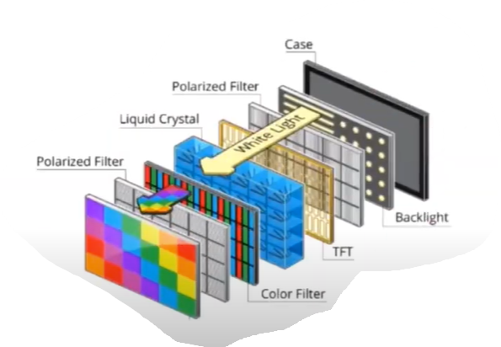
LCD(Liquide Crystal Display) Monitor
Structure: Composed of several layers: backlight, polarizers, liquid crystal layer, color filters, and glass substrates.
Light Source: Backlight (usually LED) illuminates the display.
Polarization: Light passes through the first polarizer, which aligns the light waves.
Liquid Crystal Control: Liquid crystals change orientation when an electric voltage is applied, controlling light passage to the second polarizer.
Color Generation: Each pixel has subpixels (red, green, blue). Adjusting voltage in each subpixel produces different colors.
Image Formation: The combination of light from subpixels creates the full image, allowing for dynamic content.
LCD Display

Slide 28
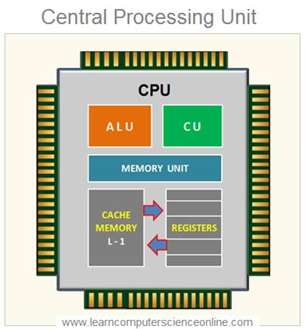
Processing Hardware(CPU)
ALU (Arithmetic Logic Unit):
Performs mathematical operations (addition, subtraction, multiplication, division) and logical operations (AND, OR, NOT).
Control Unit (CU):
Directs the operation of the processor by interpreting instructions from programs and coordinating other components (memory, ALU, I/O devices).
Memory unit
The memory unit performs several important tasks related to memory management. It controls how data moves between the RAM and the CPU and also manages the cache memory. It stores all the data and instructions needed for processing and ensures that the memory is protected.
Buses:
Data, control, and address buses are used respectively to transfer data, signals, and memory addresses between the CPU, memory, and other components.

Slide 29
Factors for CPU Speed
Clock Speed: Clock speed, measured in GHz (gigahertz), defines how many cycles (or instructions) the CPU can process per second. A higher clock speed allows the CPU to perform more tasks in a given time.
Number of Cores: A CPU with multiple cores can handle multiple tasks simultaneously. More cores (e.g., dual-core, quad-core) can improve multitasking and overall performance.
Cache Memory: CPUs have small, high-speed memory (L1, L2, and L3 caches) that stores frequently used data for quick access. Larger cache sizes can boost performance by reducing the time needed to access memory.
Bus Speed: The speed at which data is transferred between the CPU and other components affects performance.
Thermal Design and Cooling: The CPU's ability to maintain performance without overheating depends on effective cooling solutions. Overheating can cause throttling, reducing CPU speed.

Slide 30
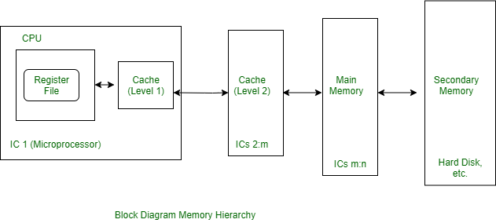
Memory
The memory is the device that provides the storage space in computer or any other digital system where data is to be processed and instructions required for processing are stored.
Functional Block Diagram of Memory:

Slide 31
Memory Classification
Memory
Main Memory
Secondary Memory
RAM
ROM
Direct Access
Sequential Access
Hard Disk
Floppy Disk
Optical Disk
Magnetic Tape
CD-ROM
CD-R
CD-W

Slide 32
Continue..
Volatile Memory:
A type of memory that requires continuous power supply to maintain the stored data is called a volatile memory. If the power supply to the memory is turned off, the data stored in it will be lost. Therefore, it is also termed as temporary memory.
Non-Volatile Memory:
A type of memory which can retain stored data even when no power supply is present is known as non-volatile memory. It is also known as permanent memory and is used for long-term storage of digital data.
Sequential Access Memory:
A type of memory in which the stored data and information is accessed in a predefined sequential manner is known as a sequential access memory.
Random Access Memory:
Random access memory, also called as direct access memory, is a type of memory in which the desired data can be accessed directly, without going through the preceding data. Hence, this memory allows to access any data in any order.

Slide 33
Main Memory
Primary storage often referred to simply as memory, is the only one directly accessible to the CPU. The CPU continuously reads instructions stored there and executes them as required.
Features:
Consists of device that directly accessible by the CPU
Much faster than secondary memory
Capable containing small storage
Typically Volatile
Types of Main Memory:
Random Access Memory(RAM)
Read Only Memory(ROM)

Slide 34
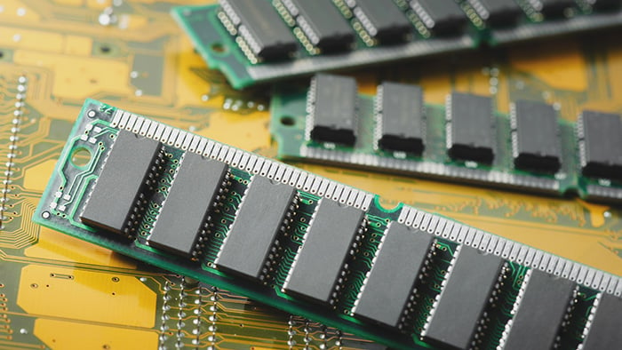
RAM(Random Access Memory)
It is also called read-write memory or the main memory or the primary memory .
The programs and data that the CPU requires during the execution of a program are stored in this memory.
It is a volatile memory as the data is lost when the power is turned off.
RAM is typically used to store the operating system, application programs, and data that the computer is currently using.

Slide 35
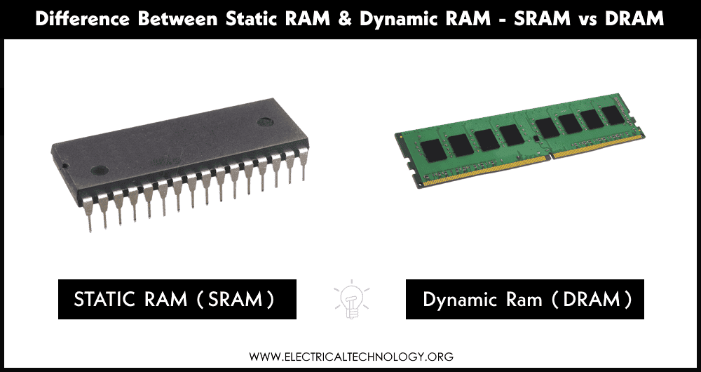
Types of Random Access Memory (RAM)
Static Random Access Memory (SRAM)
Data is stored in transistors and requires a constant power flow. Because of the continuous power, SRAM doesn’t need to be refreshed to remember the data being stored. SRAM is called static as no change or action i.e. refreshing is not needed to keep the data intact. It is used in cache memories.
Dynamic Random Access Memory (DRAM)
Data is stored in capacitors. Capacitors that store data in DRAM gradually discharge energy, no energy means the data has been lost. So, a periodic refresh of power is required in order to function. DRAM is called dynamic as constant change or action(change is continuously happening) i.e. refreshing is needed to keep the data intact. It is used to implement main memory.

Slide 36
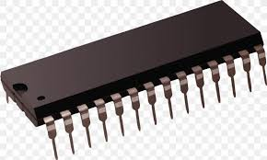
ROM(Read Only Memory)
ROM is a non-volatile memory.
Information stored in ROM is permanent.
Information and programs stored on it, we can only read and cannot modified.
Information and programs are stored on ROM in binary format.
It is used in the start-up process of the computer.

Slide 37
Types of ROM
PROM (Programmable Read-Only Memory):
PROM stands for Programmable Read-Only Memory. Generally, it’s a blank memory chip. It can be programmed during manufacturing and cannot be changed or erased.
EPROM (Erasable Programmable Read-Only Memory):
EPROM stands for Erasable Programmable Read-Only Memory. It can be programmed and later erased by exposing it to strong ultraviolet light. After being erased, the EPROM can be reprogrammed.
EEPROM (Electrically Erasable Programmable Read-Only Memory):
EEPROM stands for Electrically Erasable Programmable Read-Only Memory. It is an advanced type of ROM that can be erased and reprogrammed electrically. This operation can be repeated indefinitely, and the computer system can do it while running. The EEPROM allows users to program and erase any desired spot

Slide 38
Secondary Memory
Memory that has a larger storage capacity and from which data and programs are not lost when the computer is turned off. Such a type of memory is called secondary memory. In secondary memory, programs and data are stored. It is also called auxiliary memory.
Features:
It is non-volatile, i.e. it retains data when power is switched off
It is large capacities to the tune of terabytes
It is cheaper as compared to primary memory

Slide 39
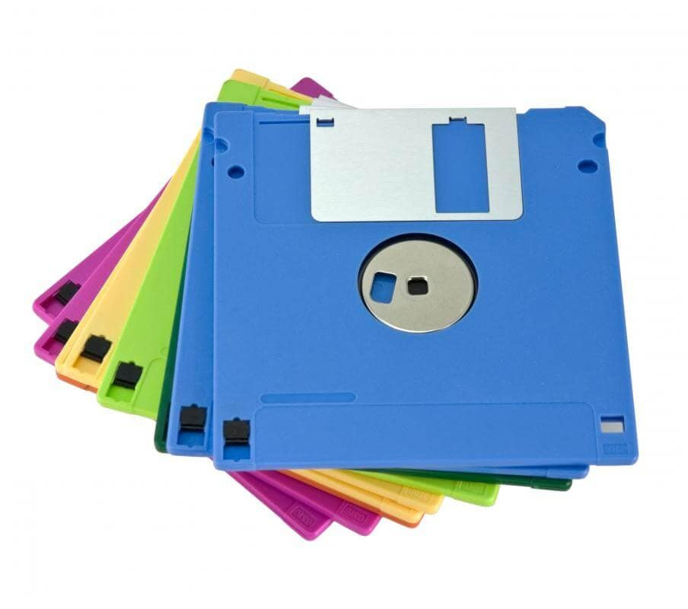
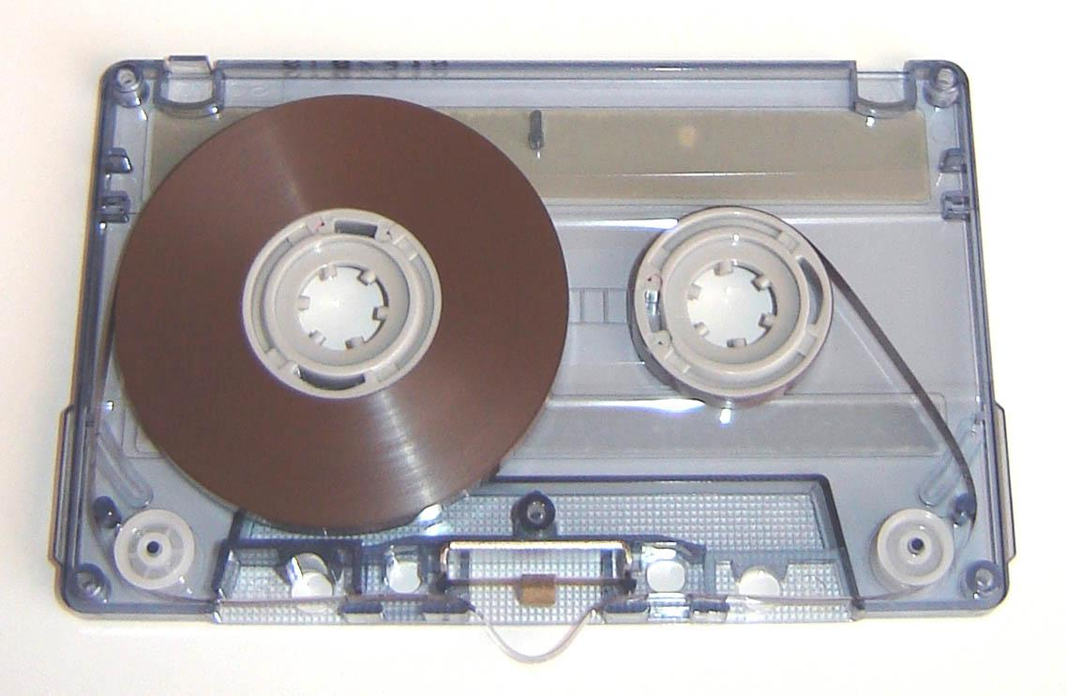
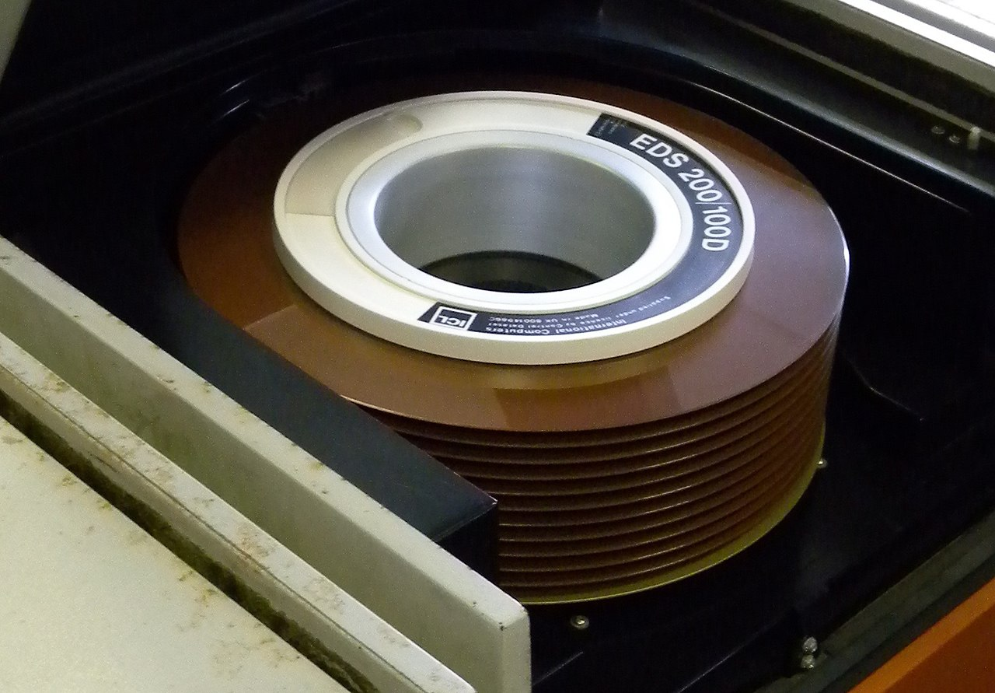
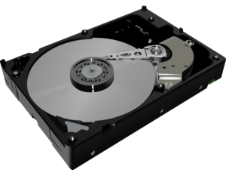
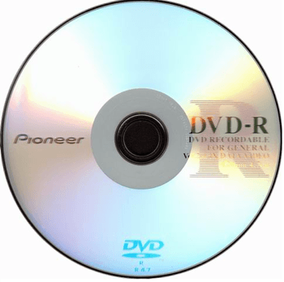
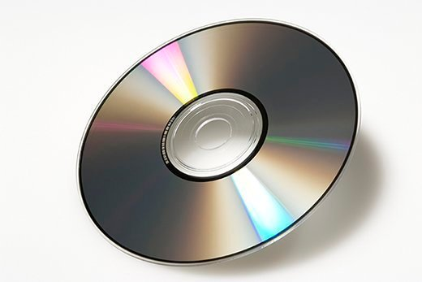
Continue…
Magnetic Tapes
Floppy Disk
Disk Packs
Magnetic Disk
CD
DVD

Slide 40
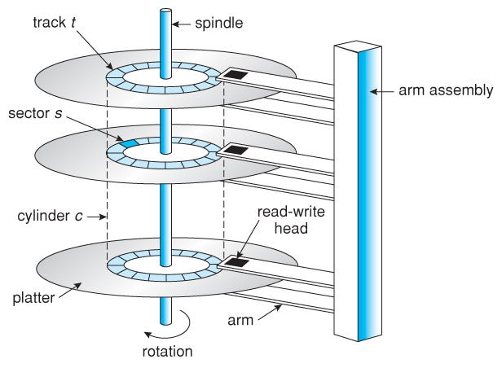
Hard Disk
An HDD has two main functions: storing data and providing space for the computer's operating system and applications. Data is stored on the disk platters in concentric circles called tracks. The tracks are divided into sectors, each of which can hold a certain amount of data. The readwrite heads move across the track and read or write data as the disk rotates past them.

Slide 41
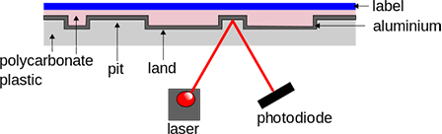
Optical Disk
Optical Disk is a storage medium that relies on laser technology to read and write data, in shape, it is a flat circular disk which is made up of polycarbonate or a similar material with a very shiny reflective layer on the surface. They are mainly used for sharing, storing and backup Data.
Example: CD(Compact Disk), DVD(Digital Versatile Disk)

Slide 42
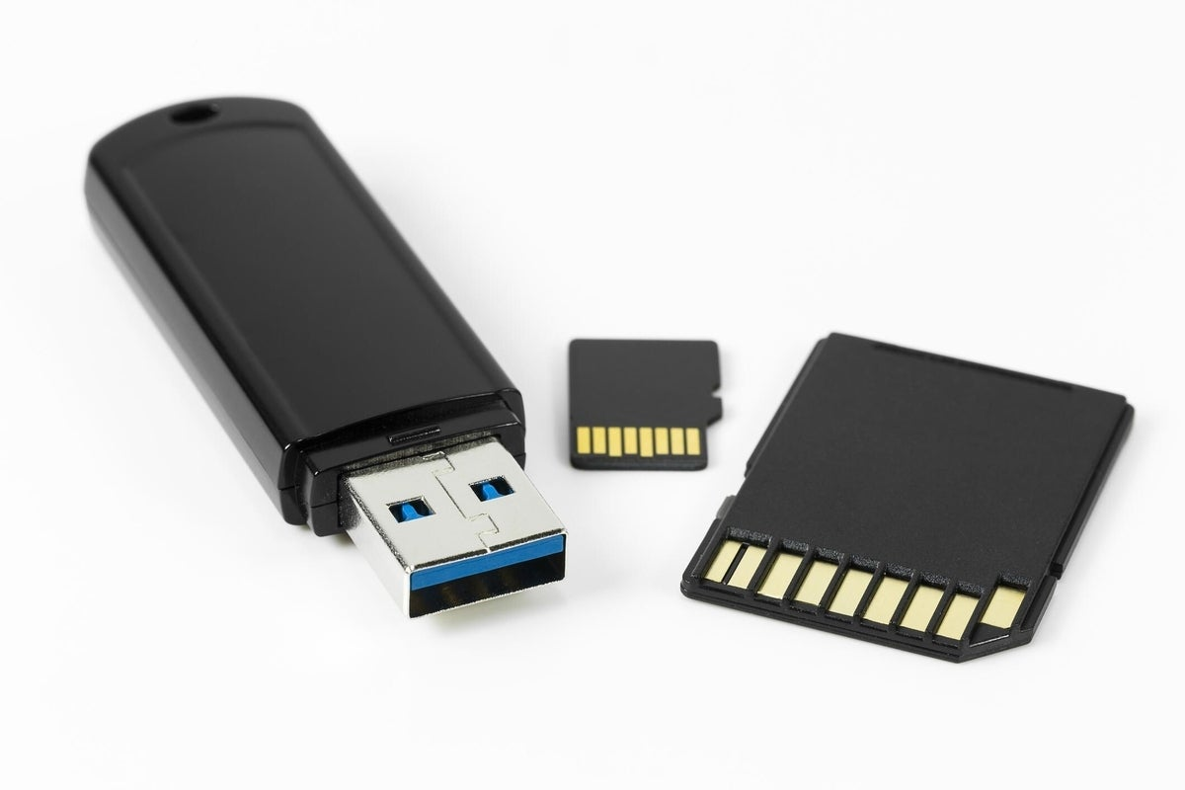
Flash Memory
Flash memory is secondary memory and so it is not volatile which means it persists the data even if there is not an electrical supply provided. This flash memory works on the principle of EEPROM. EEPROM stands for Electrical Erasable Programmable Read-Only Memory. ROM operation can only one time write and many times read and we can’t erase it. But Flash Memory can be erased multiple times and update the data or program integrated into it.

Slide 43
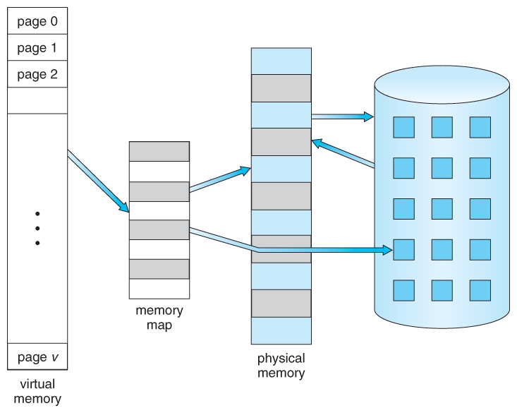
Virtual Memory
Virtual Memory is a storage scheme that provides user an illusion of having a very big main memory. This is done by treating a part of secondary memory as the main memory.
In this scheme, User can load the bigger size processes than the available main memory by having the illusion that the memory is available to load the process.
Instead of loading one big process in the main memory, the Operating System loads the different parts of more than one process in the main memory.
By doing this, the degree of multiprogramming will be increased and therefore, the CPU utilization will also be increased.

Slide 44
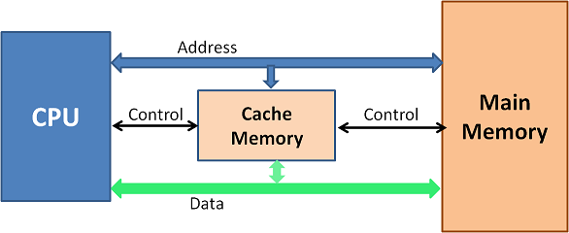
Cache
Cache memory is an extremely fast memory type that acts as a buffer between RAM and the CPU.
Cache Memory holds frequently requested data and instructions so that they are immediately available to the CPU when needed.
Cache memory is costlier than main memory or disk memory but more economical than CPU registers.
Cache Memory is used to speed up and synchronize with a high-speed CPU.

Slide 45


